Slide 1
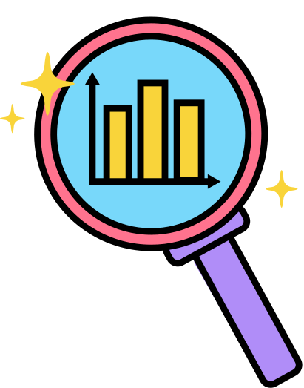
ANALYSIS OF FOOD AND BEVERAGE INDUSTRY
Notes:
Here we will be Starting with analysis of food and beverage industry

Slide 2
DATA
This dataset provides an in-depth look into consumer behavior and preferences in the food and beverage sector. It captures details on consumption patterns, including frequency and reasons for choosing specific brands, as well as consumer perceptions and prior experiences. Key insights include health concerns, interest in natural products, and preferred marketing channels and packaging. Additionally, it covers price sensitivity and purchase locations. This comprehensive data offers valuable information for tailoring marketing strategies, enhancing product offerings, and understanding consumer needs.
Notes:
Welcome to the delicious world of consumer behavior in the food and beverage industry! 🌟 Dive into our dataset, and you'll uncover the secrets behind why people choose the brands they do. From health-conscious choices and a love for natural products to the ideal marketing channels and packaging preferences – we’ve got the inside scoop!
Key bites of insight:
Health Concerns: Why your salad is more popular than a burger.
Natural Products: The rising trend of 'green' in our shopping carts.
Marketing Channels: Where consumers are most likely to notice your brand.
Price Sensitivity: The sweet spot between affordability and indulgence.
Purchase Locations: From online shopping sprees to supermarket strolls.
This treasure trove of data is your recipe for crafting spot-on marketing strategies, refining your product offerings, and truly understanding what your customers crave. So, let’s cook up some success with these insights!

Slide 3
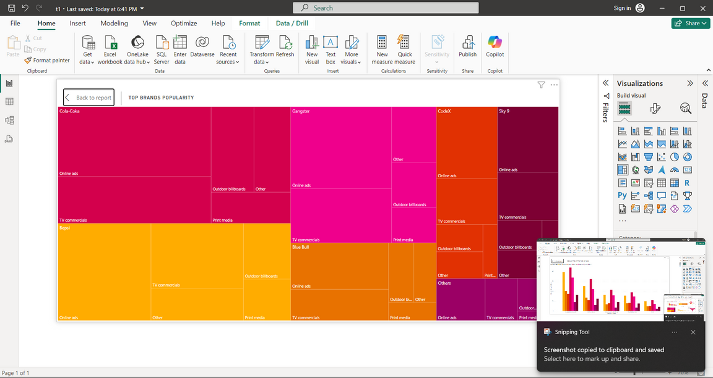
An analysis of a brand's popularity and marketing tactics using a treemap derived from survey respondents' frequency of hearing the brand name can yield important insights into customer awareness and perception. Businesses may use this graphic depiction to better understand their market positioning and plan out their next marketing initiatives.
Notes:
Let’s dive into the world of brand visibility with a treemap! This nifty chart visualizes how often survey respondents hear a brand’s name, offering a clear picture of its popularity. By analyzing this data, businesses can gauge their market presence and tailor their marketing strategies. It’s like a map that shows where your brand stands and where to go next!

Slide 4
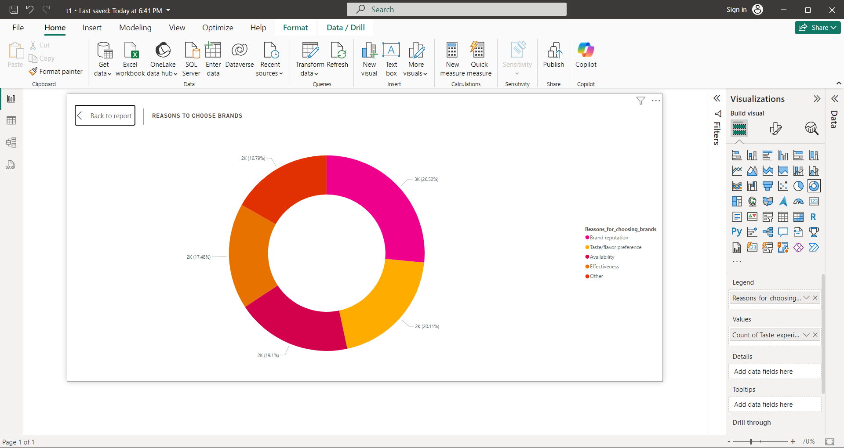
This graphic illustrates why consumers select particular brands; factors that draw them in include availability, taste, and reputation of the beverage. What is the factor of purchase? Aside from pricing and packaging, people's brand preferences may also be influenced by recommendations from friends and family. In the end, buyers could consider a mix of these aspects when deciding what to buy. Ultimately, the decision to purchase a particular brand may be a combination of personal experiences, marketing strategies, and social influences. These factors all play a role in shaping consumer behavior and brand loyalty.
Notes:
Here’s a look at what drives brand choices, displayed in a donut chart! This graphic breaks down why people pick certain brands, highlighting key factors like availability, taste, and reputation. But wait, it’s not just about price or packaging—recommendations from friends and family can sway decisions too. In the end, it's a blend of personal experiences, marketing efforts, and social influences that shape brand loyalty and purchasing behavior.

Slide 5
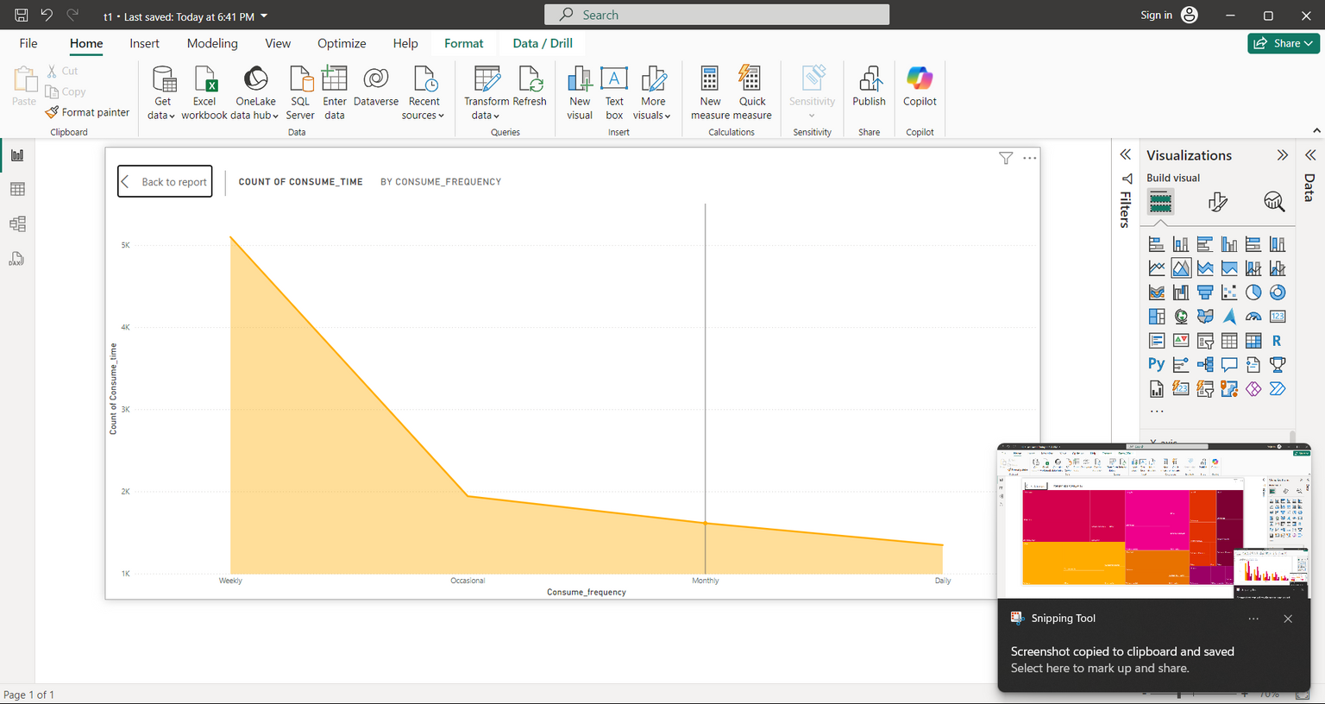
Area Line Chart: This illustrates how consumers drink different types of beverages; weekly consumption is higher than daily and monthly consumption, which is much lower than weekly consumption. This graph may be used to spot patterns in beverage consumption patterns over time and provide guidance for marketing campaigns aimed at encouraging daily and monthly consumption. By analyzing the data presented in the area line chart, companies can tailor their marketing strategies to target specific consumption patterns and increase overall sales. Understanding these trends can help businesses anticipate consumer behavior and adjust their product offerings accordingly.
Notes:
Here’s an area line chart that reveals how beverage consumption varies over time. Weekly drinking is on the rise, while daily and monthly habits lag behind. This visual helps identify consumption trends, offering insights for crafting marketing campaigns aimed at boosting daily and monthly sales. By examining these patterns, companies can fine-tune their strategies, align their offerings with consumer habits, and ultimately drive higher sales.

Slide 6
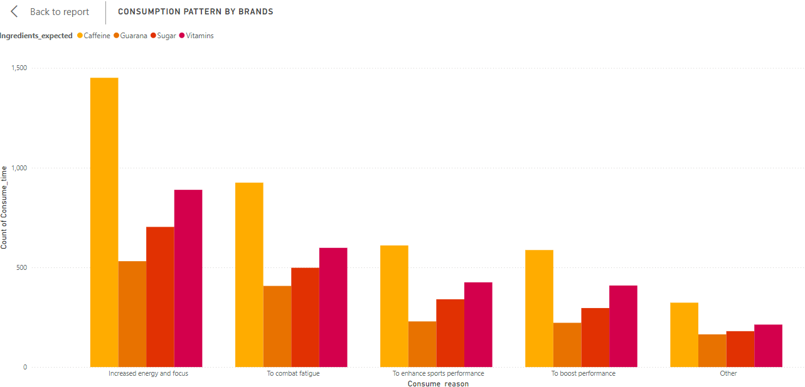
This stacked bar chart visualizes the usual beverage-drinking scenarios and highlights the types of beverages that consumers or ingeridents are most likely to consume. This kind of graphic gives us a clear picture of consumption patterns by making it simple to compare the amounts of various substances or beverages ingested in each scenario. Based on the data provided, it can assist in identifying customer trends and preferences.
Notes:
Check out this stacked bar chart showcasing typical beverage-drinking scenarios! It neatly displays which drinks or ingredients are most popular in different settings. By comparing these quantities, we get a clear view of consumption patterns, helping us spot customer trends and preferences. This chart makes it easy to see what people enjoy and where their tastes lie

Slide 7
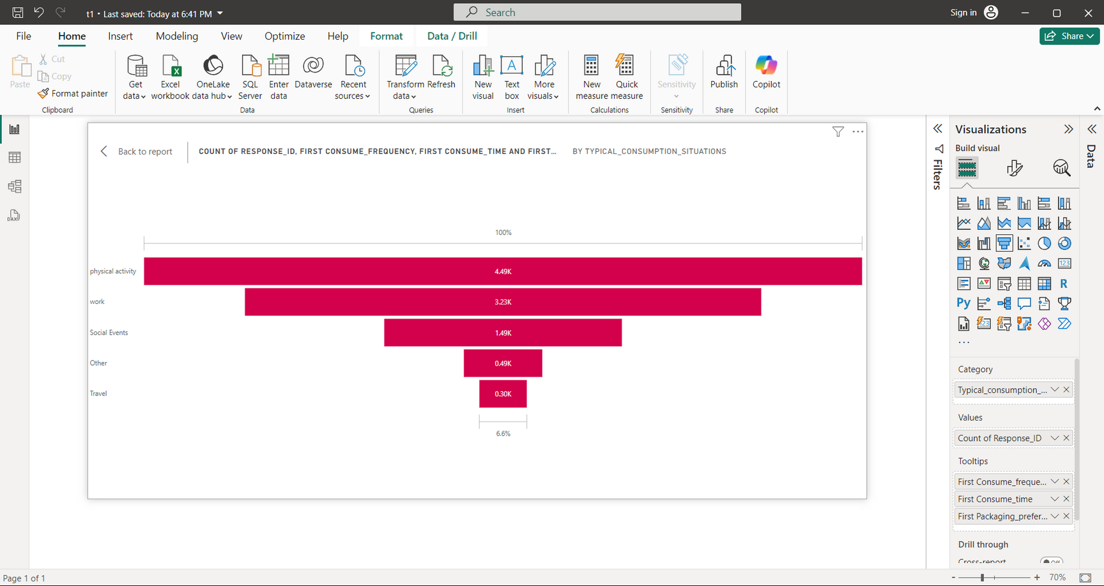
This funnel chart illustrates the common beverage-drinking environments and highlights the beverage types that consumers or ingredients are most likely to consume. This kind of graphic gives us a clear picture of consumption patterns by making it simple to compare the amounts of various drugs or beverages eaten in each scenario. The provided data can be used to identify customer trends and preferences. For instance, it's evident that people like to drink coffee in the morning, but they choose to drink alcoholic beverages in social situations. Businesses may better satisfy client wants and take advantage of market trends by customizing their offers based on the analysis of this data.
Notes:
Here’s a funnel chart that maps out typical beverage-drinking settings and preferences. It clearly shows which drinks are favored in various scenarios—like coffee in the morning and alcoholic beverages at social events. This visual helps businesses pinpoint consumption patterns and tailor their offerings to meet customer desires. By understanding these trends, companies can better align their products with consumer habits and seize market opportunities.

Slide 8
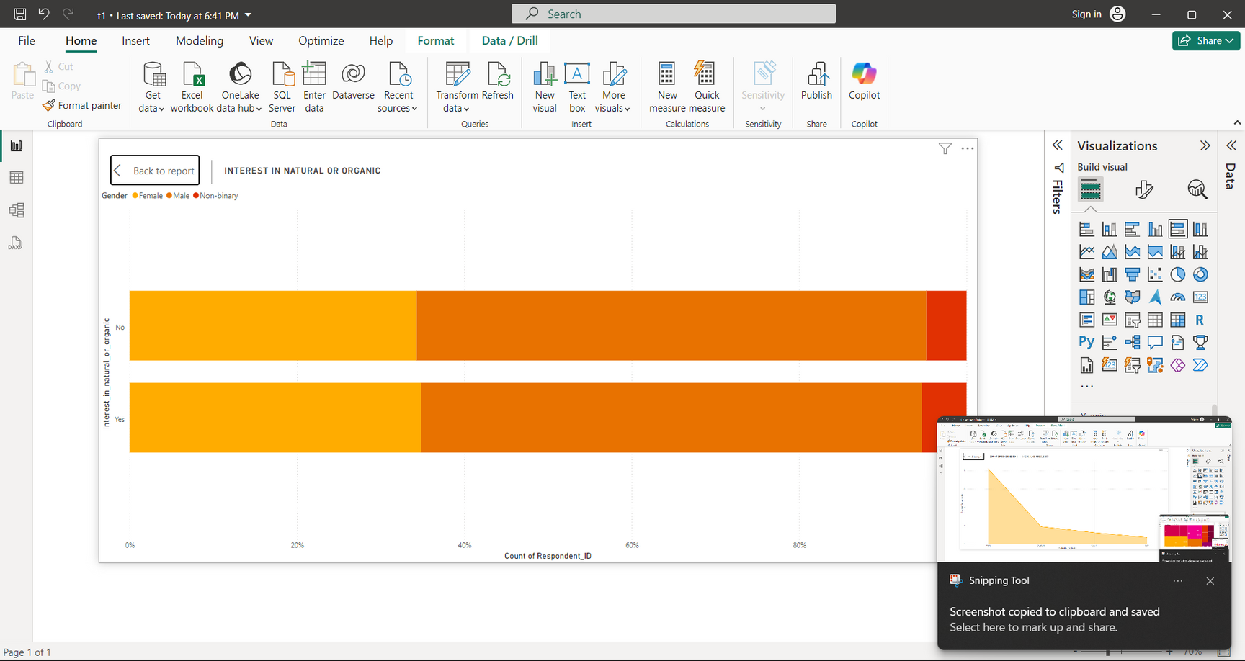
This illustrates which gender is more concerned about health. What preferences do our customers have for their beverages to be on the healthier, more natural, or organic side? Understanding our customers' preferences for healthier, more natural, or organic beverages can help us tailor our offerings to better meet their needs. By analyzing this data, we can also gain insights into potential market trends and opportunities for growth in the health-conscious consumer segment. In order to adjust our product offers, we aim to comprehend customer trends and preferences. We can better serve the health-conscious market and raise consumer satisfaction by examining this data.
Notes:
Let’s explore who’s more health-conscious with this chart! It shows the gender preference for healthier, natural, and organic beverages. By understanding these preferences, we can adjust our product offerings to better cater to health-focused consumers. Analyzing this data helps us spot market trends and growth opportunities in the wellness segment, allowing us to enhance consumer satisfaction and better meet their needs.

Slide 9
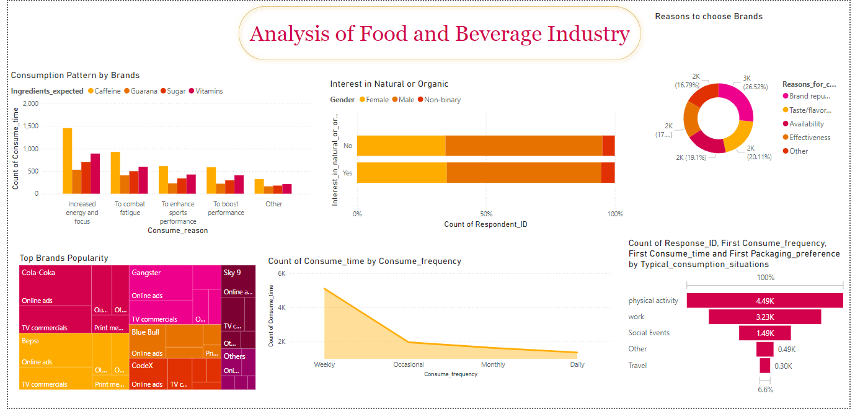
FINAL DASH BOARD

Slide 10
This interactive dash board has one purpose: it shows us what our customers are eating, what they like, whether there is a health trend or wave where people are choosing natural or organic beverages, what are the best and most effective digital marketing strategies, what are the most popular beverages and how to create a market for them, how to get people addicted to a drink, and finally, how to boost sales and brand loyalty. To keep ahead of the competition in the beverage sector, businesses may make well-informed decisions about product development, marketing tactics, and consumer interaction by examining the statistics displayed in these infographics.
Notes:
This interactive dashboard is your go-to tool for all things beverage-related! It reveals what customers are drinking, their preferences, and emerging health trends towards natural and organic options. Plus, it provides insights into the best digital marketing strategies, popular beverages, and ways to build market presence and boost sales. By analyzing this data, businesses can make informed decisions about product development and marketing tactics, ensuring they stay ahead in the competitive beverage market.

Slide 11

BY :SMRUTI SONEKAR
BATCH:MIP-DA-13

